Slide 1
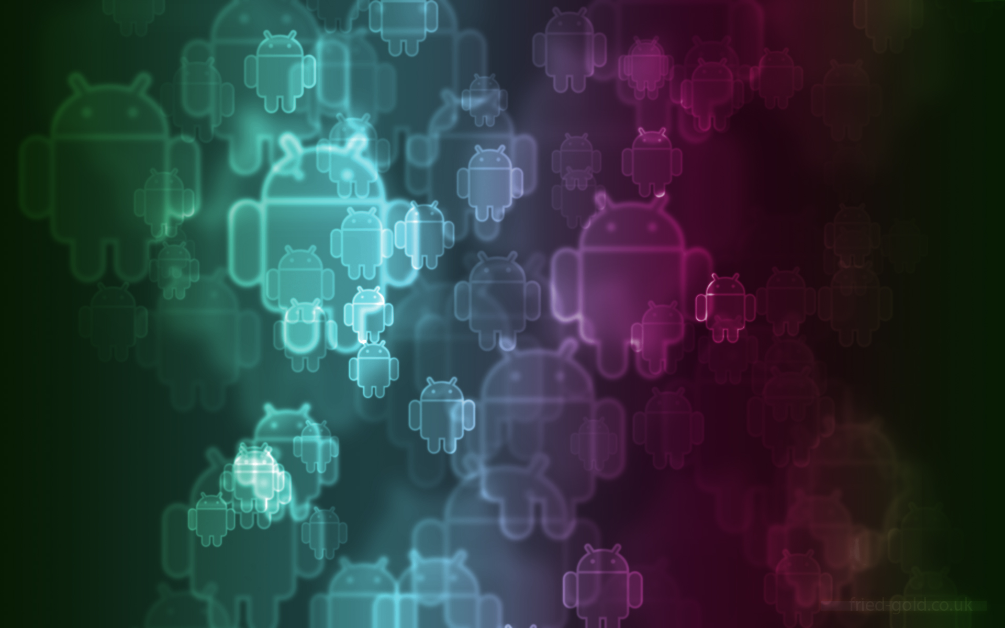
A short Quiz Android Application(PAREEKSHA)
Project Guide
Mr. Rajeev Singh
Submitted By:-
Himank Gupta (40388)
Madhudeep Petwal (40379)
Gaurav Pande (40400)
Rahul Singh Kashyap (42086)

Slide 2

Contents
Objective
Motivation
What is Android?
Android SDK
Android versions.
Technologies Used
MySQL
HTML
Google Play services
PHP framework

Slide 3
Contents
Components Of the Application:
Interface
Database
Web connectivity
Wi-Fi connectivity
Results
Pros-cons
Future possibilities
Conclusion.

Slide 4
Objective
An Android Application that will assist the teachers to take short quiz randomly during classes.
It will consist of Multiple Choice Questions which will be answered by students.
Solutions will be submitted to the web server or a local server and evaluation will be done accordingly.

Slide 5
Motivation
To organize surprise test or quizzes by teacher, it takes a lot of resources and time.
Evaluation of each student is very time consuming for a teacher in a batch of large strength.
So in due course these important part of curriculum get missed and as a result a student get aloof from the very crucial steps of concepts building in a particular subject.

Slide 6
What Is Android?
Android was founded by Andy Rubin at Palo Alto, California in 2003.
Google, famous for its dominating web search portal, entered the market with a Linux kernel-based product: Google Android.
It is based on 2.6- series Linux kernel.
On September 2013, Google announced that one billion devices uses now android OS worldwide.

Slide 7
What Is Android?
The operating system has been enriched with all necessary elements that are required to provide basic functions like a networking stack, GSM/GPRS abilities, and more.
On top of all this, Google offers a framework containing a rich set of Java methods enabling developers to create a wide range of software for mobile use on Google Android.

Slide 8
What Is Android?
Google usually refers to the Android OS as a software stack. Each layer of the stack groups together several programs that support specific system functions.

Slide 9
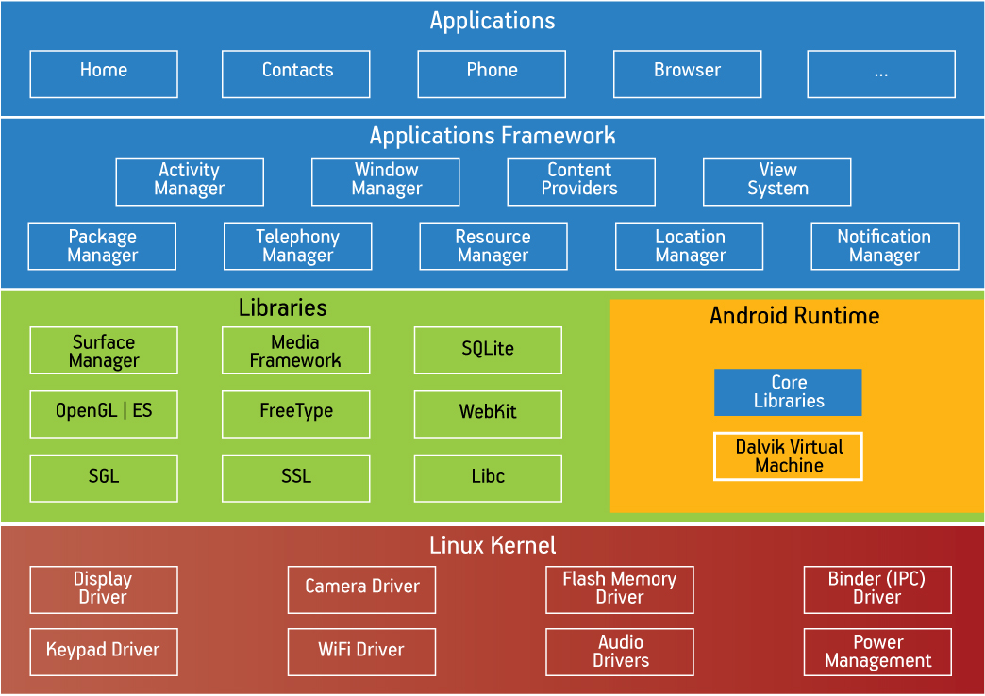
What Is Android?
Android Architecture

Slide 10
The Google Android SDK
A main element of the SDK is the actual Google Android Emulator which provides a graphical emulation of a possible handheld device running Google Android
To make things easier, Google suggests Eclipse as the IDE to be used.
For this, Google optionally provides an Android Plug-in made for Eclipse that will take over a few basic tasks.

Slide 11

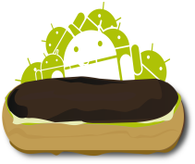

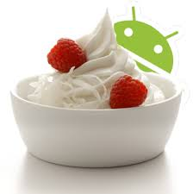
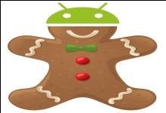

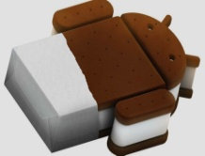
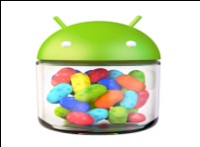
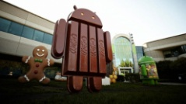
Android Versions So Far..
Cupcake (Android 1.5) Donut (Android 1.6) Éclair (Android 2.0, 2.0.1, 2.1)
Froyo (Android 2.2 - 2.2.3) Gingerbread (2.3-2.3.2 & 2.3.3- 2.3.7) Honeycomb (Android 3.0,3.1,3.2)
Ice Cream Sandwich Jelly Bean (Android 4.1, 4.3)
(Android 4.0-4.2 & 4.0.3-4.0.4)
KitKat (Android 4.4,4.4.3)

Slide 12
Technologies Used..
MySQL
MySQL, the most popular Open Source SQL database management system, is developed, distributed, and supported by Oracle Corporation.
MySQL is a database management system.
MySQL databases are relational.
A relational database stores data in separate tables rather than putting all the data in one big storeroom.

Slide 13
Technologies Used..
The SQL part of ―MySQL stands for - Structured Query Language.
SQL is the most common standardized language used to access databases. Depending on your programming environment, you might enter SQL directly (for example, to generate reports), embed SQL statements into code written in another language.
Benefit of using MySQL software is that it is Open Source.
The MySQL Database Server is very fast, reliable, scalable, and easy to use.

Slide 14
Technologies Used..
HTML
HTML, initials of Hypertext Markup Language, is the predominant markup language for web pages. It provides a means to describe the structure of text-based information in a document — by denoting certain text as headings, paragraphs, lists, and so on.

Slide 15
Technologies Used..
Google Play Services
Google Play services provide you with easy access to Google services and are tightly integrated with the Android OS.
The application that we built in Eclipse after publishing is hosted in this Google Play services on the web.
Users from all over the world can download the application using this web service.
Any later updates or important changes made by the application is finally made available for users on this website of Google play services.

Slide 16
Technologies Used..
PHP Framework
PHP is a server site scripting language designed for web development but also used as a general purpose programming language.
PHP originally stood for Personal Home Page, it now stands for PHP: Hypertext Preprocessor.
PHP has been widely ported and can be deployed on most web servers on almost every operating system and platform, free of charge

Slide 17
Technologies Used..
PHP is inspired from Perl.
This included Perl-like variables, form handling, and the ability to embed HTML. The syntax resembled that of Perl but was simpler, more limited and less consistent.
Our project implements PHP in building the web application by imbedding html.

Slide 18
Components of the Application
Interface
Database
Web Connectivity
Wi-Fi connectivity

Slide 19
Interface
According to the role of a user , interface is divided into two parts mainly 1. Admin or teacher
2. User or student
Admin or teacher will be provided a dashboard to upload questions and their answers.
User or Student will be provided a dashboard to attempt questions and submit their answers.

Slide 20
Database
There will be following tables 1. Paper details . 2. Admin or teacher profile. 3. User or student profile. 4. Paper’s Id. 5. Students who have given tests.

Slide 21
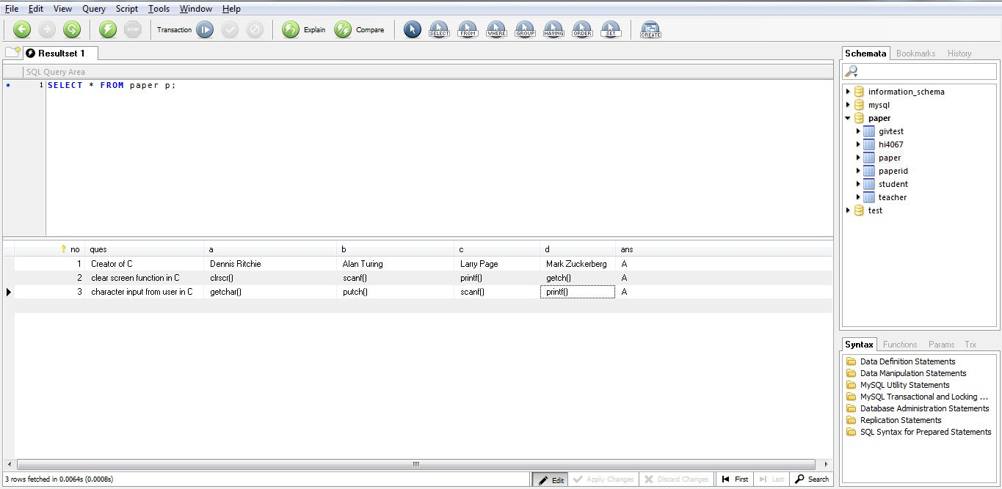
Database
Paper Details

Slide 22
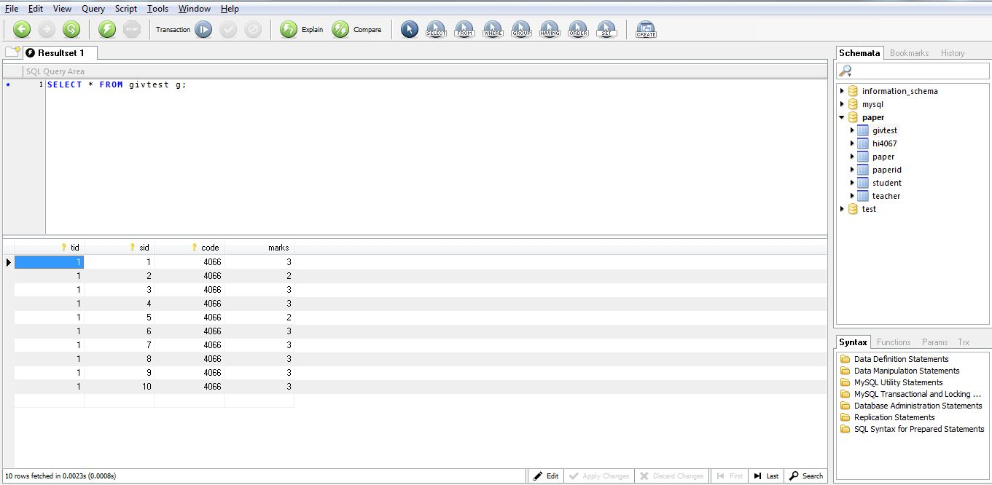
Database
Students who have given tests

Slide 23
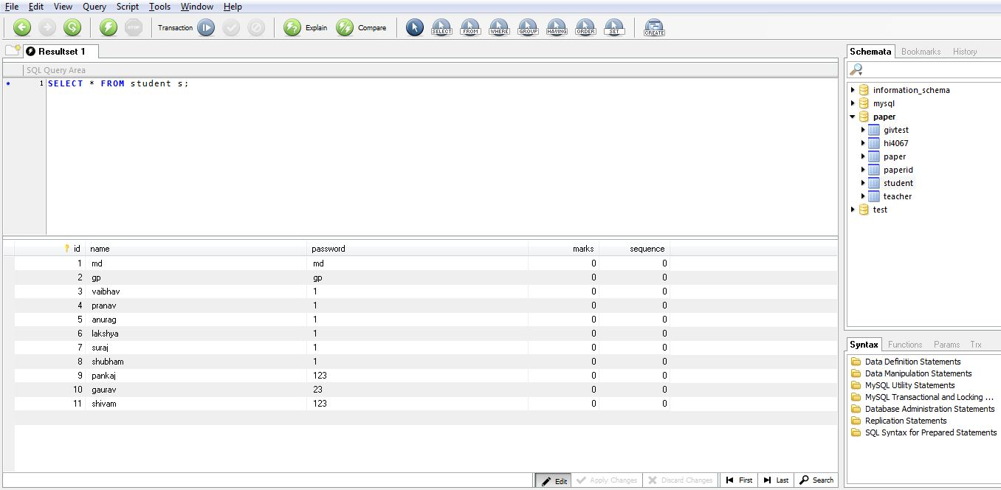
Database
Student Details

Slide 24
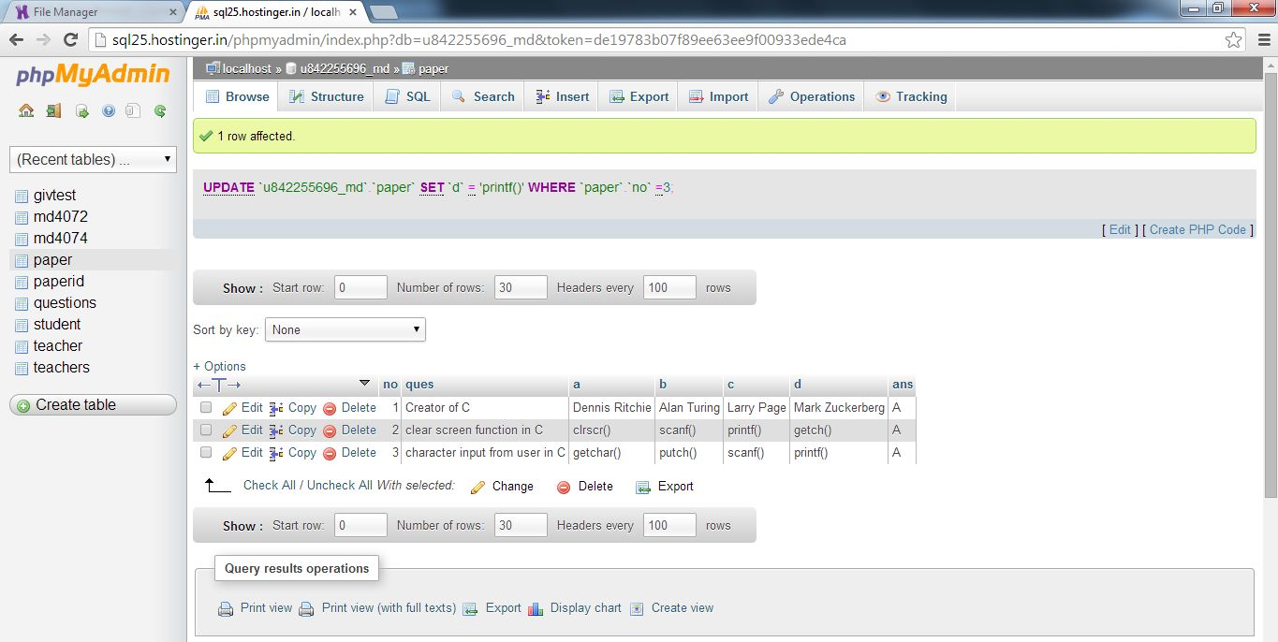
Database
phpMyAdmin of database

Slide 25
Web Connectivity
There will be a login page for students and teachers.
There will be a web server handling the requests online.
For e.g. during quiz hours all the activities of students and teachers will be acknowledged by the web server.
All the answers submitted by all students will be stored in the database.

Slide 26
Wi-Fi-connectivity
Wi-Fi connectivity to the application is made available using the local server for providing services like database connectivity, and intent initiation.
User can access the application by connecting to the local access point.
The web connectivity is made available by using Virtual Router Redundancy protocol.

Slide 27
Wi-Fi-connectivity
The Virtual Router Redundancy Protocol (VRRP) is a computer networking protocol that provides for automatic assignment of available Internet Protocol (IP) routers to participating hosts.
The protocol achieves this by creation of virtual routers, which are an abstract representation of multiple routers.
Without this protocol it is not possible to made connection from a computer to Smartphone.

Slide 28
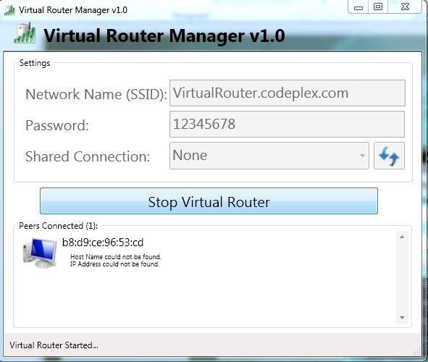
Wi-Fi-connectivity
Virtual Router Manager

Slide 29
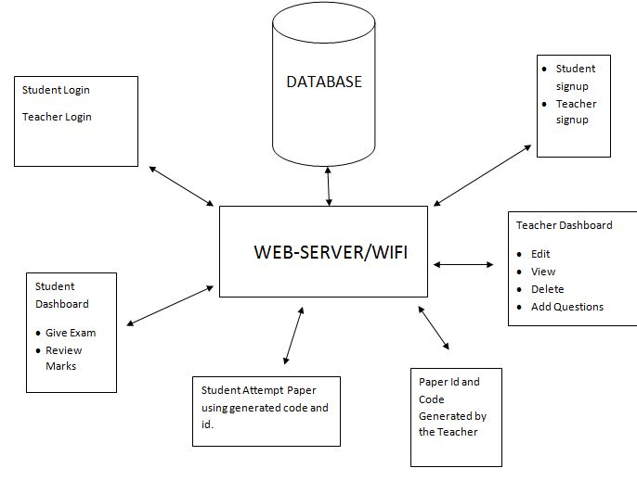
Results..

Slide 30
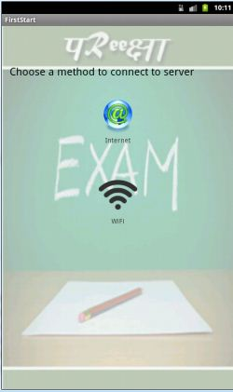
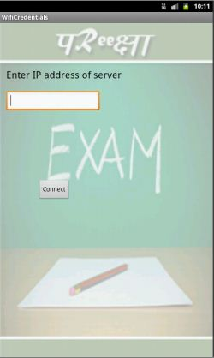
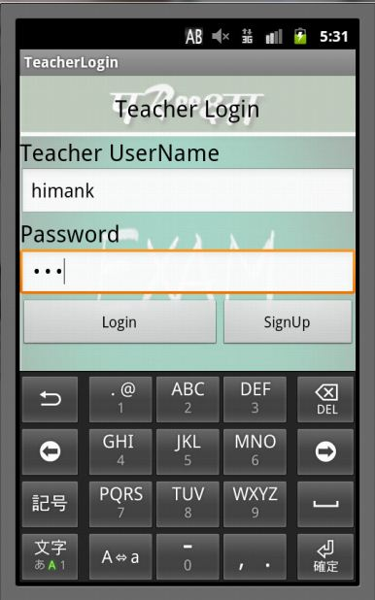
Results..
Choosing server
Entering server IP address
Teacher
Login

Slide 31
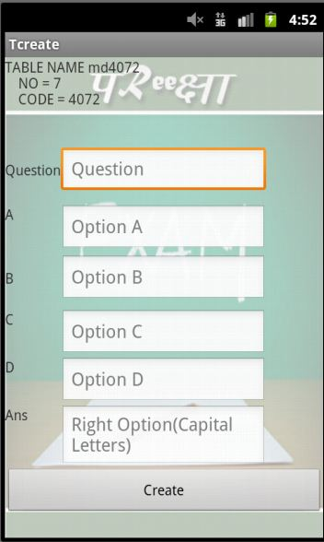
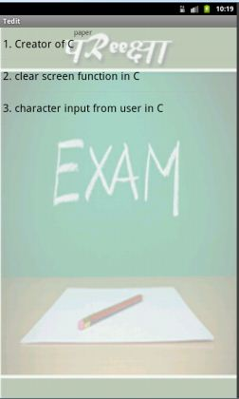
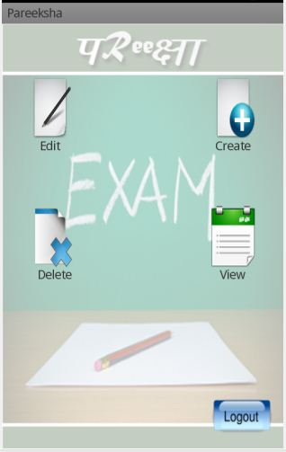
Results..
Teacher DashBoard
Create Paper
Edit Paper

Slide 32
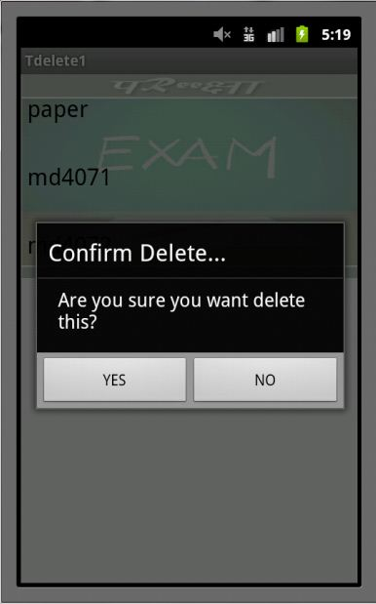
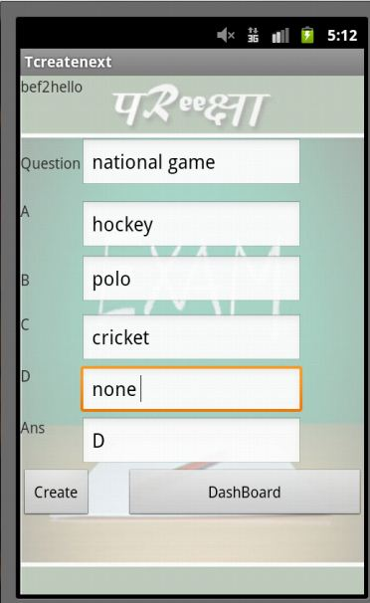
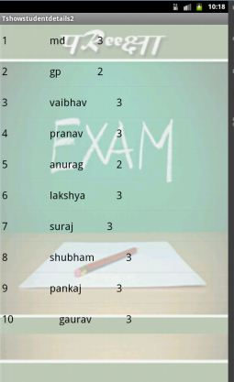
Results..
View Student Performance
Creating Paper
Deleting Paper

Slide 33
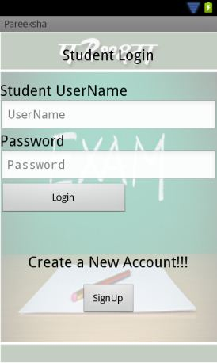
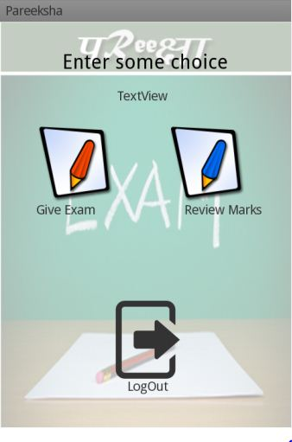
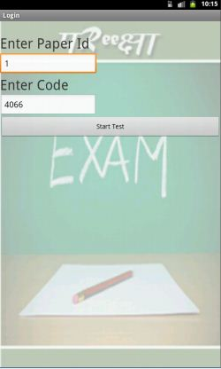
Results..
Entering Paper Details
Student Login
Student Dashboard

Slide 34
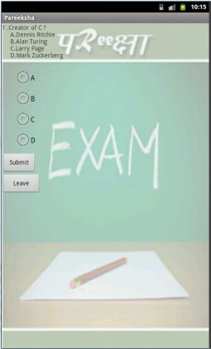
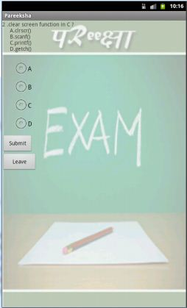
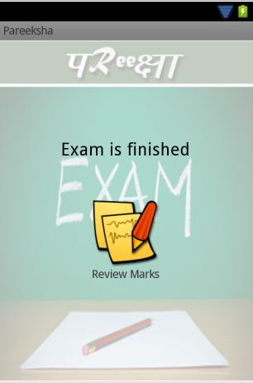
Results..
View Marks
Giving Exam

Slide 35
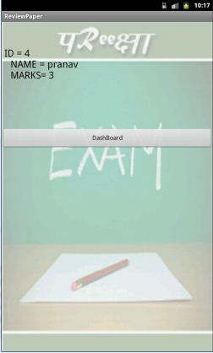
Results..
Performance

Slide 36
Pros - Cons
Pros
A simple and elegant application for organizing a quick exam.
Very fast as it runs on Android OS and it also occupies very less memory.
Most importantly this application can work offline also using Wi-Fi connectivity.
It can be very beneficial in organizing the elimination of industrial recruitment process.

Slide 37
Pros - Cons
Cons
Security issues regarding questions stored in database.
Essential requirements is that every student should have Android phones.
Presently it is working on the Gingerbread version of android OS.

Slide 38
Future Possibilities
So far we have built a formulated problem into an application, but as a team we will be focusing to further built this application with the following points in mind :
It can be made available for any platform of android OS.
Security components like encryption of data will be added in web connectivity component.
It can be made available for the window platform also.
Attendance dashboard will be added on this application .

Slide 39
Conclusion
In this fast changing technological era , education should be benefited by technology and ideas, and these two should step up coherently.
So in this Application we have tried to merge this simple idea with this Android technology.

Slide 40
THANK YOU

